Slide 1
Relational model design
By:
Rimjhim Singh,
Asst. Prof,
CSE Deptt.

Slide 2
Features of good relational design
DESIGN ALTERNATIVE: LARGER SCHEMAS
Combine Schemas?
DESIGN ALTERNATIVE: SMALLER SCHEMAS

Slide 3
Combine Schemas??
Consider combining relations
Sec_class (sec_id, building, room_number)
Section (course_id, sec_id, semester, year)
Resulting schema
Section (course_id, sec_id, semester, year, building, room_number)
No data redundancy / repetition
Schema can be easily combined.

Slide 4
Combine Schemas
Inst_dept
Instructor
ID
name
salary
dept_name
Department
dept_name
building
budget
Suppose we combine Instructor and Department schemas into Inst_dept entity set.
inst dept (ID, name, salary, dept name, building, budget)
And drop the relationship Inst_dept between the two schemas

Slide 5
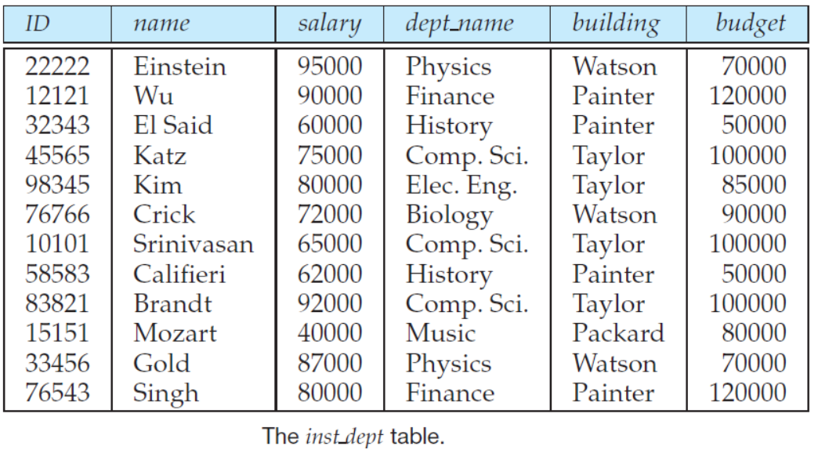
Combine Schemas
Consider Computer Science Department
Example : Consider rows where name = ‘Katz’, ‘Srinivasan’ and ‘Brandt’.

Slide 6
Combine Schemas
Data redundancy is a common problem.
Example : Consider rows where name = ‘Katz’, ‘Srinivasan’ and ‘Brandt’.

Slide 7
Combine Schemas
Causes anomalies due to redundancy:
Update :
Example: Change in budget for CSE deptt. should be reflected in all the records corresponding to CSE deptt.
Problem : Inconsistent data.
Insert :
Example: Details about a new department cannot be inserted until it has at least one employee.
Problem: NULL values will be inserted.
Delete :
Example: If details about CSE deptt are to be deleted, then the details about its faculties will also be deleted.
Problem: Loss of data

Slide 8
Smaller Schemas ????
Suppose we had started with inst_dept.
How would we know to split it up into instructor and department ?
By analyzing data
(Unreliable Process).
Tedious for schema with many attributes.
Very costly
No repetition of data can be just a special case.
Need to check all the constraints
Example: Each dept_name has only one budget and resides only in one building.

Slide 9
Smaller Schemas ????
Write a rule “ if there were a schema
(dept_name, building, budget) then dept_name should be able to serve as a primary key”.
This rule is referred to as “Functional Dependency”.
dept_name → budget
In inst_dept schema, dept_name cannot be a primary key.
Hence, budget and building will be repeated.
Hence, inst_dept needs to be decomposed.

Slide 10
Smaller Schemas ????
Not all decompositions are good.
Suppose we decompose
employee (ID, name, street, city, salary)
Schema as follows:
employee1 (ID, name)
employee2 (name, street, city, salary)
Uniquely we can represent data.
Problem arises when two persons have same name

Slide 11
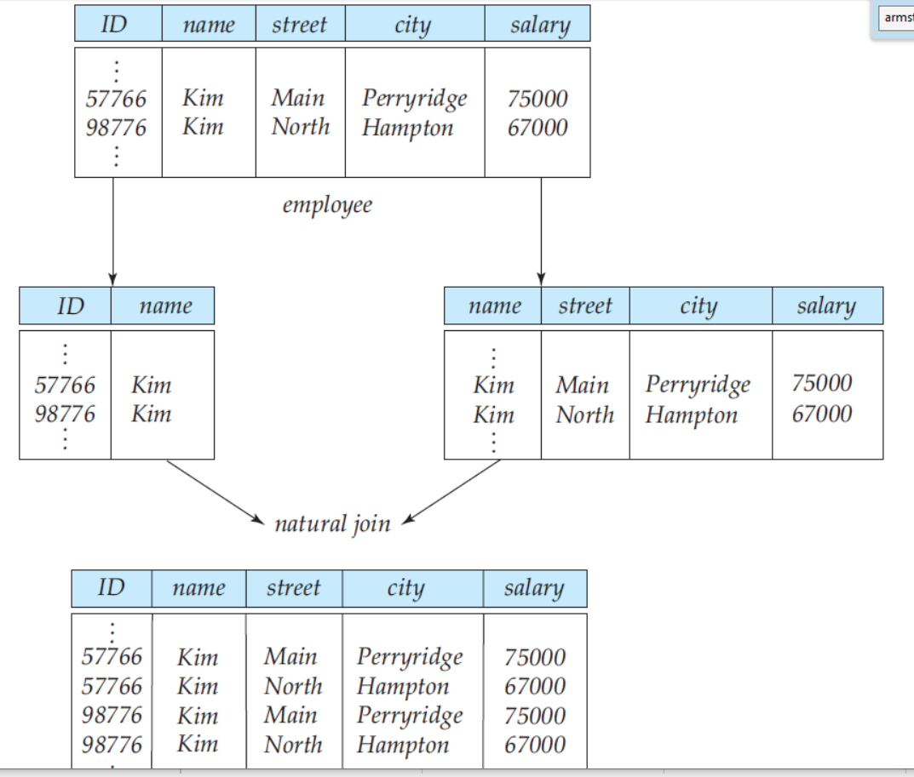
Smaller Schemas ????
Lossy decomposition
- Two valid tuples.
- Two invalid tuples
- Cannot reconstruct origination data.

Slide 12

Smaller Schemas ???
Decomposition can be either:
Lossy decomposition
Lossless Decomposition
Lossless Decomposition
Decompose R (A, B, C) into R₁ (A, B) and R₂ (B, C)
R₁
R₂
R
A | B | C
α | 1 | a
β | 2 | b
A | B
α | 1
β | 2
B | C
1 | a
2 | b
A | B | C
α | 1 | a
β | 2 | b
Original data of R has been reconstructed.
Hence, Lossless Decomposition

Slide 13
Functional Dependence
Functional dependency is a constraint on a set of legal relations.
Generalized notion of keys.
A relationship where values of a certain set of attributes uniquely determine the values of certain other set of attributes.

Slide 14
Functional Dependence
Consider a relation schema R (A_{1,} A_{2,} A_{3.......} A_{n}), and
let X and Y be two sets of attributes, such that
X ⊆ R and Y ⊆ R
An instance r of R satisfies X→Y, if
For any two tuples t₁, t₂ in R,
if t₁[X] = t₂[X]
Then t₁[Y] = t₂[Y]
If X → Y, we say X functionally determines Y or Y is functionally dependent on X.
A functional dependency is a property of semantics of the attributes, i.e., a property of the relation schema.
They must hold on all relation states of R.

Slide 15
Functional Dependence
Example:
A → B
Yes, All values in A uniquely define
values on B
B → A
No, t₁, t₂, t₃ uniquely identify A but
t₄(B) = t₅(B) and
t₄(A) ≠ t₅ (A)
A → A
Yes, unique identification
B → B
Yes, unique identification
AB → B
Yes, unique identification
A | B
1 | a
2 | b
3 | c
4 | d
5 | d
t₁
t₂
t₃
t₄
t₅

Slide 16
Functional Dependence
Example:
A → B
No t₁(A) = t₁(A) but
t₁(B) ≠ t₁ (B)
B → A
Yes, t₁, t₂, t₃ uniquely identify A and
t₄(B) = t₅(B) and
t₄(A) = t₅ (A)
B → C
Yes, t₁, t₂, t₃ uniquely identify Cand
t₄(B) = t₅(B) and
t₄(C) = t₅ (C)
A | B | C
1 | 10 | a
1 | 20 | b
2 | 30 | c
3 | 60 | c
3 | 60 | c
t₁
t₂
t₃
t₄
t₅

Slide 17
Functional Dependence
Example:
AC → B
Yes, t₁, t₂, t₃ (A,C)uniquely identify B
t₄(A,C) = t₅(A,C) and
t₄(B) = t₅ (B)
BC → A
yes t₁, t₂ (B,C) uniquely identify A
t₃(B,C) = t₄(B,C) and
t₃(B) ≠ t₄ (B)
B → AC
Yes t₁, t₂ ,t₃ (B) uniquely identify (A, C)
t₄(B) = t₅(B) and
t₄(A,C) = t₅ (A,C)
A | B | C
1 | 10 | a
1 | 20 | b
2 | 30 | c
3 | 60 | c
3 | 60 | c
t₁
t₂
t₃
t₄
t₅

Slide 18
Types of Functional Depndency
Trivial functional dependency
Non-trivial functional dependency
Multivalued dependency
Transitive dependency

Slide 19
Types of Functional Depndency
Trivial functional dependency
The dependency of an attribute on a set of attributes is known as trivial functional dependency if the set of attributes includes that attribute.
Gives the already known information.
Need not check the relation data for verification.
Symbolically:
For set of attributes X and Y,
X →Y is trivial functional dependency
if Y is a subset of X.
In previous example
A→A , B →B, AB →B, AB →A all are trivial FDs

Slide 20
Types of Functional Depndency
Non-Trivial functional dependency
If a functional dependency X →Y holds true where Y is not a subset of X then this dependency is called non trivial Functional dependency.
Gives new information.
Need to check the relation data explicitly for verification.
Symbolically:
For set of attributes X and Y,
X →Y is a non-trivial functional dependency
if Y is a not subset of X.
In previous example
B→A , B →C, B →AC, all are non-trivial FDs

Slide 21
Armstrong Axioms
Reflexivity rule.
If X is a set of attributes and Y ⊆ X ,
then X → Y holds.
Augmentation rule.
If X → Y holds and Z is a set of attributes, then XZ → YZ holds.
Transitivity rule.
If X → Y holds and Y → Z holds,
then X → Z holds.

Slide 22
Armstrong Axioms
Reflexivity rule.
If X is a set of attributes and Y ⊆ X ,
then X → Y holds.
Augmentation rule.
If X → Y holds and Z is a set of attributes, then XZ → YZ holds.
Transitivity rule.
If X → Y holds and Y → Z holds,
then X → Z holds.

